Slide 1
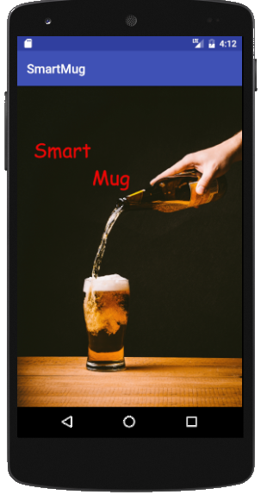
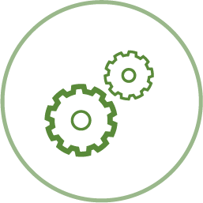

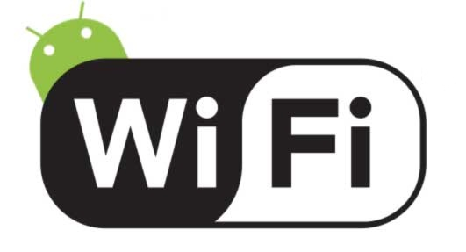

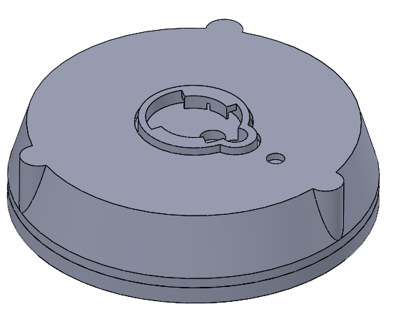
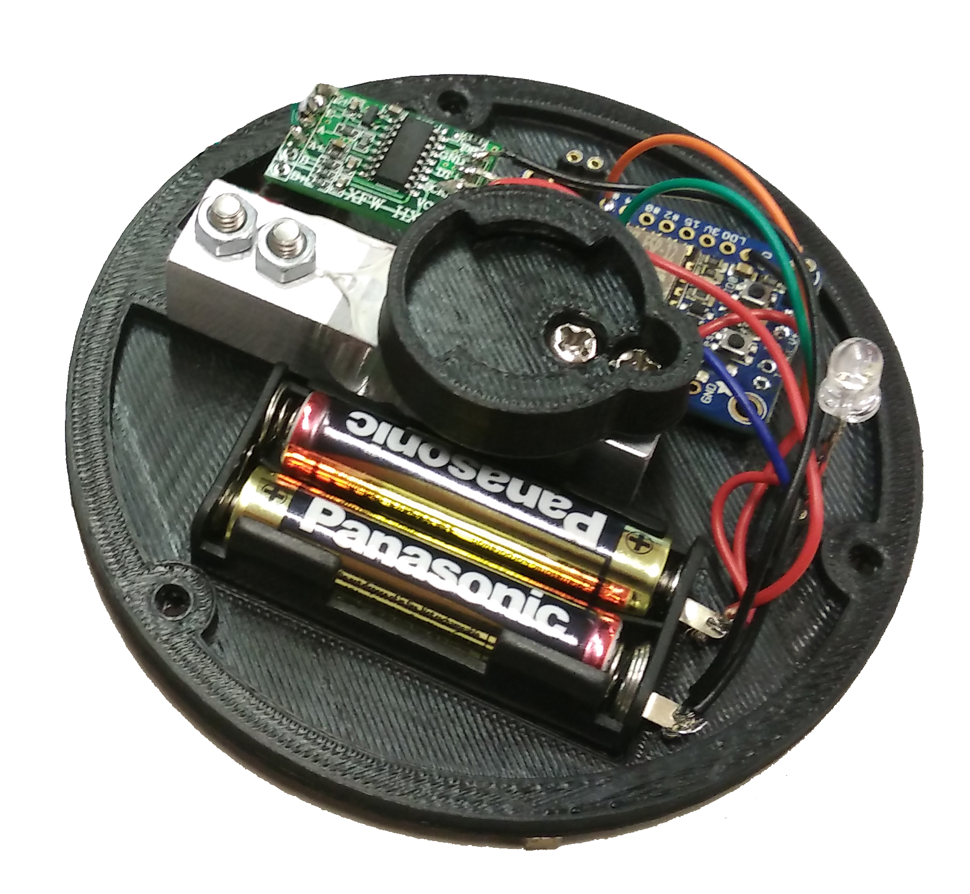
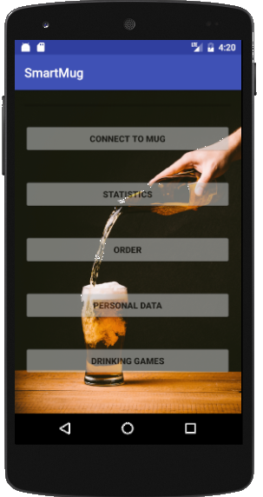
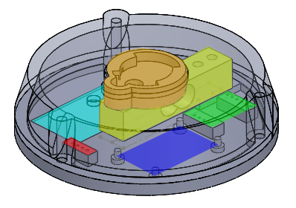
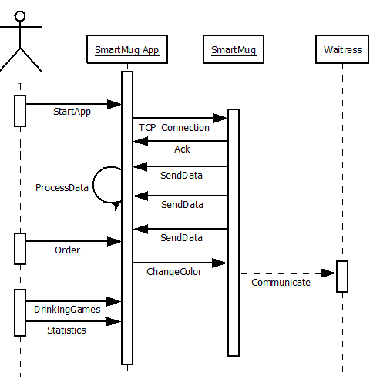
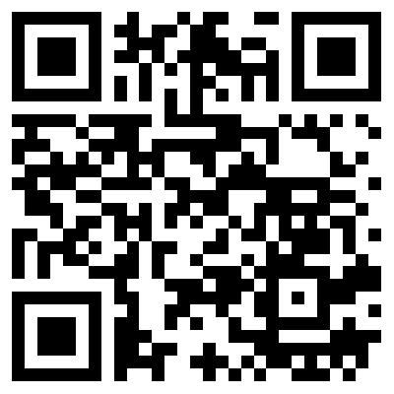

SmartMug The clever way to order
Martin Dold, Larraitz Orio,
Gürkan Karacocuk, Dennis Tritschler
Architecture
Connects to the SmartMug
Wireless Communication
Standard Mug
Extension to make your mug smart
Functions
Connection to mug via bar code reading
Liquid level sensing via weight (HX711 circuit)
Drinking statistic analysis via app
Interactive drinking games via app
Waitress communication by changing mug color
SmartMug
SmartMug App
HX711
Bayonet mount
Connect to your
SmartMug via Bar Code
or by entering
manuell the IP Adress
Load cell
Adafruit Huzzah
Display some
statistics like promile
Batteries
RGB-LED
Enter your personal Data
for some statistics
Case
Order via SmartMug
Play some drinking
games
Connection
SmartMug Protocol
TCP/IP → Wireless LAN according to
IEEE802.11b/g standard
Multicast DNS:
Service name: smartmug
Service type: _smartmug._tcp
Sequence diagram
Tag 1byte | Length 1byte | Value n bytes | End of Frame 1 byte
Outlook
- Connection to the barkeeper → Live data for the barkeeper, direct re-order function
- Payment via app
- Capacitive measurement instead of weight
- Connection between taps and SmartMug for automated and exact measurement of the filling level
More Details under:
https://github.com/martin-dold/smartMug

